Slide 1
Mini project
Freshness of Food Detection using IoT and Machine Learning
AASHRITH RACHERLA (221710302001)
M.Kiran Sastry BVS MAHIDHAR (221710302008)
(Project guide) MOTUPALLY SUNDARA CHARYA(221710302038)
PRANAVI PULICHEARLA(221710302050)

Slide 2
Contents
Base Paper
Problem Statement
Feasibility Study
Architecture of Machine Learning Project
Design of Machine Learning Project
Conclusion

Slide 3
Base Paper
Journal name : International Conference on Emerging Trends in Information Technology and Engineering (ic-ETITE)
Published in : 2020
Publisher : IEEE
Input - CSV file (coma separated values file).
Output - Whether the food is spoilt or not.
Algorithm - Logistic Regression

Slide 4
Problem Statement
In today's world, food spoilage is a crucial problem as consuming spoiled food is harmful for consumers.
Our project aims at detecting spoiled food using appropriate sensors and monitoring gases released by the particular food item.
We plan on implementing machine learning to this model so we can estimate how likely a food is going to get spoiled and in what duration, if brought from a particular vendor.

Slide 5
Feasibility Study
A feasibility study is an analysis that takes all of a project's relevant factors into account—including economic, technical, legal, and scheduling considerations—to ascertain the likelihood of completing the project successfully.
Technical Feasibility:
Jupyter Notebook
Python
Python Libraries
Economic Feasibility:
Cost/ benefits analysis of the project
As our project is academic project we will not have any cost.

Slide 6
Requirement analysis
Requirements Analysis is the process of defining the expectations of the users for an application that is to be built or modified
Libraries used:
Pandas : pandas is a software library written for the Python programming language for data manipulation and analysis.
NUMPY : NumPy is a library for the Python programming language, adding support for large, multi-dimensional arrays and matrices, along with a large collection of high-level mathematical functions to operate on these arrays.
MATPLOTLIB : Matplotlib is a plotting library for the Python programming language and its numerical mathematics extension NumPy. It provides an object-oriented API for embedding plots into applications.
SCI-KIT LEARN LIBRARY: It features various classification, regression and clustering algorithms including support vector machines.

Slide 7
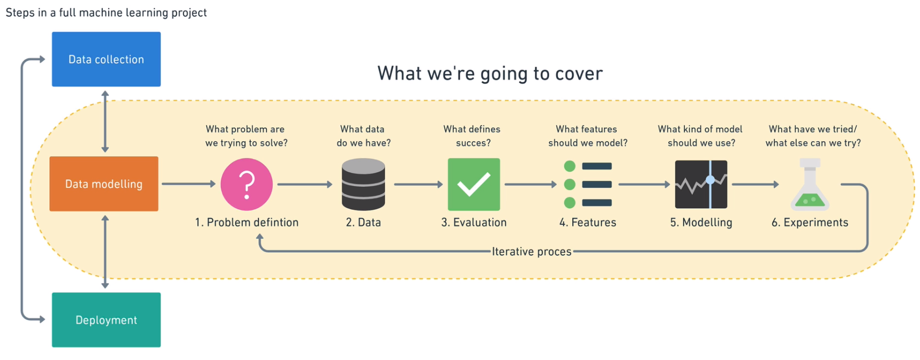
Architecture of Machine Learning Project

Slide 8
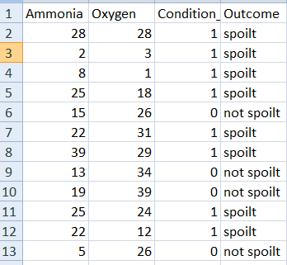
Data Collection
Data set:
We created a sample dataset of some instances of foods that were spoilt and non-spoilt
We can run the data set in different machine learning models.The model which gives the best accurate result is considered as the best model to detect whether the food is spoilt or not.

Slide 9

Data Modeling
Data Modeling involves 6 steps:
Problem Definition
What business problem are we trying to solve? How can it be phrased as a machine learning problem?
In our project we are trying to solve a Supervised Learning Problem

Slide 10
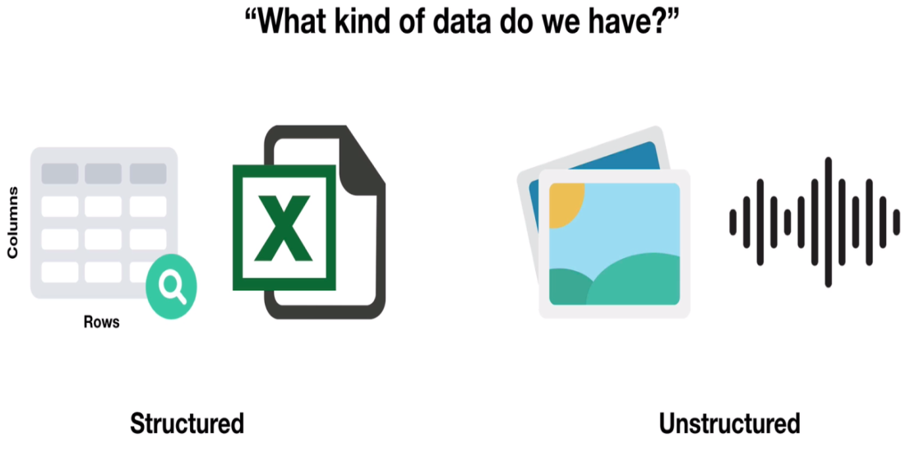
Data
If machine learning is getting insights out of data, what data we have? How does it match the problem definition? Is our data structured or unstructured? Static or streaming?
In our project we are using Structured Data which is in the form CSV(comma separated value) file.

Slide 11

Evaluation
What defines success? Is a 95% accurate machine learning model good enough?
There are different evaluation metrics for classification, regression and recommendation problems. Which one we choose will depend on our goal.

Slide 12
Features
What features does your data have and which can you use to build your model?
The three main types of features are
Categorical features
Continuous (or numerical) features
Derived features
Our data consists of Numerical features i.e. numbers.

Slide 13
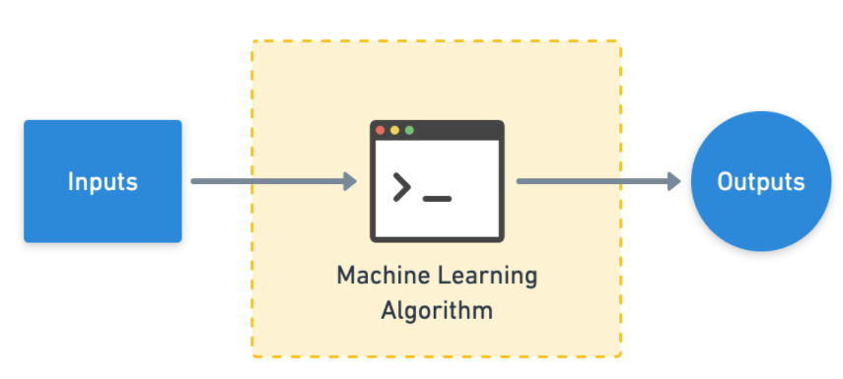
Modeling
Which model should you choose? How can you improve it? How do you compare it with other models?
Modeling breaks into three parts,
Choosing a model
Improving a model
Comparing it with others.

Slide 14
Development of Machine Learning Model
• Input: Source of Food item
• Output: Food item is spoilt or not
• Training Data: Instances of spoilt/unspoilt food item, oxygen and ammonia concentrations for each sample.
Algorithm Used
Logistic regression:
This is a machine learning model that outputs the probability of a particular input instance belonging to a particular class.
In this case output class are binary: ‘Spoilt’, ‘Not Spoilt’. Hence, we obtain its probabilities of being spoilt for different days.

Slide 15
Experimentation
What else could we try? How do the other steps change based on what we’ve found? Does our deployed model do as we expected?
This step involves all the other steps. Because machine learning is a highly iterative process, you’ll want to make sure your experiments are actionable.
Our biggest goal should be minimizing the time between offline experiments and online experiments.

Slide 16
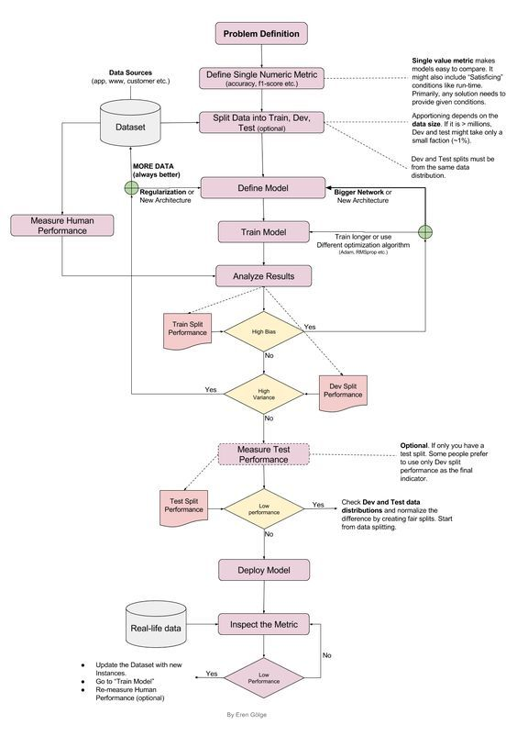
Design of Project

Slide 17
Conclusion
An exhaustive research has led us to conclude that the food industry can be revolutionized by a simple combination of sensors, IoT and machine learning. After integration, this model will create a competition between food manufacturers to sell more healthy food and create awareness among consumer to purchase more healthy food.

Slide 18
Any Queries ?

Slide 19
Thank you

